Slide 1
Mehran S. Fallah May 2020
Discrete Mathematics
Session VIII
An Introduction to Logic

Slide 2
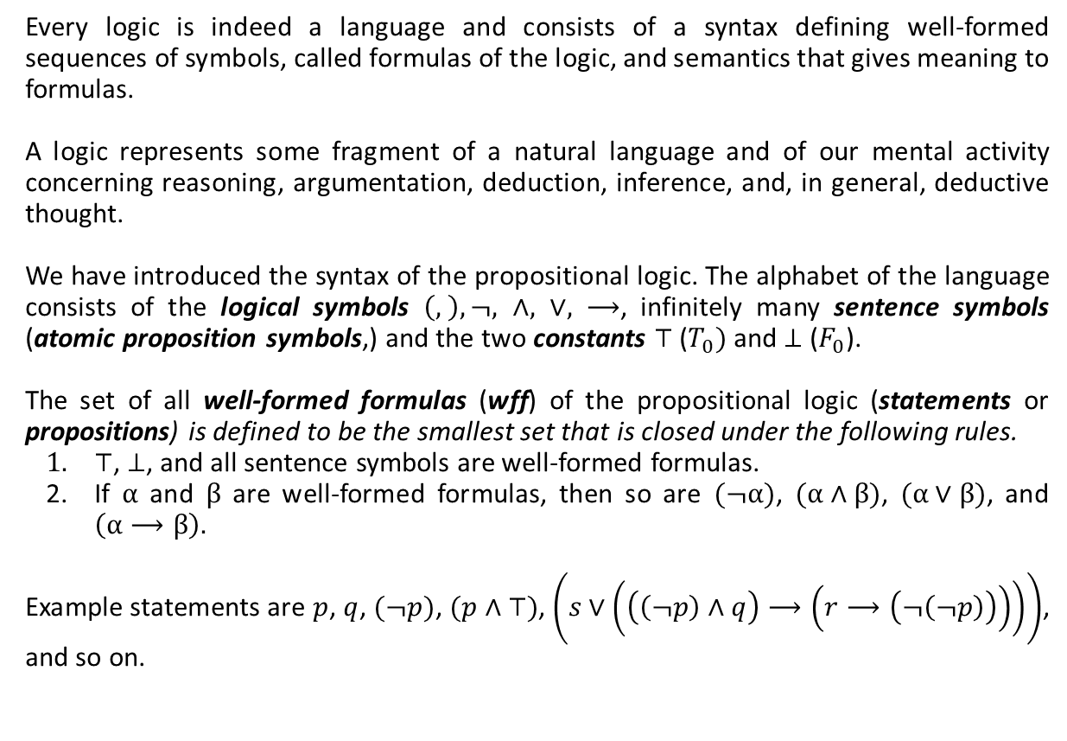
Recapitulation
Every logic is indeed a language and consists of a syntax defining well-formed sequences of symbols, called formulas of the logic, and semantics that gives meaning to formulas.
A logic represents some fragment of a natural language and of our mental activity concerning reasoning, argumentation, deduction, inference, and, in general, deductive thought.
We have introduced the syntax of the propositional logic. The alphabet of the language consists of the logical symbols $\left(, \right),¬, ∧, ∨, ⟶$, infinitely many sentence symbols (atomic proposition symbols,) and the two constants $⊤$ ($T_{0})$ and $⊥$ ($F_{0}$).
The set of all well-formed formulas (wff) of the propositional logic (statements or propositions) is defined to be the smallest set that is closed under the following rules.
$⊤$, $⊥$, and all sentence symbols are well-formed formulas.
If $α$ and $β$ are well-formed formulas, then so are $(¬α)$, $(α∧β)$, $(α∨β)$, and $\left(α⟶β\right).$
Example statements are $p$, $q$, $(¬p)$, $(p∧⊤)$, $\left(s∨\left(\left(\left(¬p\right)∧q\right)⟶\left(r⟶\left(¬\left(¬p\right)\right)\right)\right)\right)$, and so on.

Slide 3
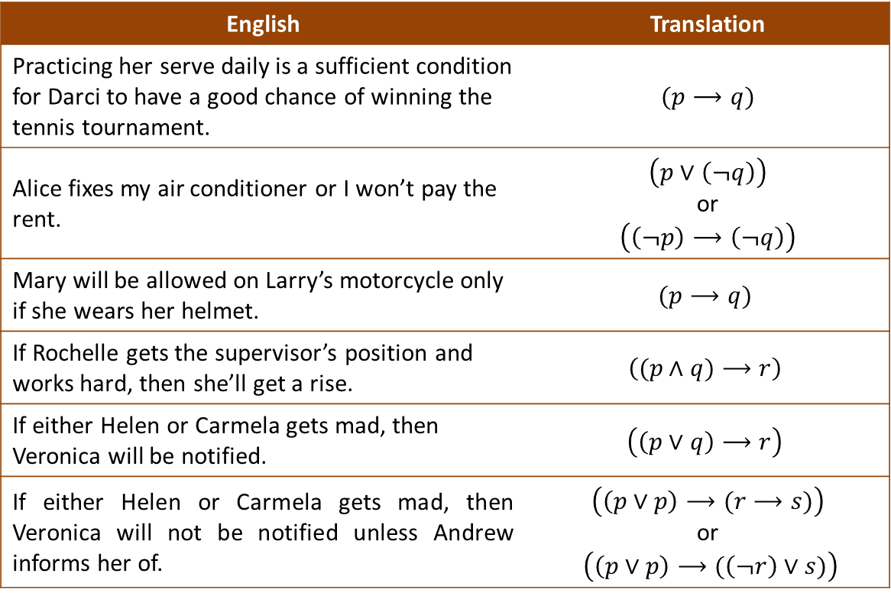
Recapitulation (Ctd.)
We can translate sentences of our natural language into the language of the propositional logic.
English | Translation
Practicing her serve daily is a sufficient condition for Darci to have a good chance of winning the tennis tournament. | $$(p⟶q)$$
Alice fixes my air conditioner or I won’t pay the rent. | $$\left(p∨\left(¬q\right)\right)$$ or $$\left(\left(¬p\right)⟶\left(¬q\right)\right)$$
Mary will be allowed on Larry’s motorcycle only if she wears her helmet. | $$(p⟶q)$$
If Rochelle gets the supervisor’s position and works hard, then she’ll get a rise. | $$\left((p∧q)⟶r\right)$$
If either Helen or Carmela gets mad, then Veronica will be notified. | $$\left(\left(p∨q\right)⟶r\right)$$
If either Helen or Carmela gets mad, then Veronica will not be notified unless Andrew informs her of. | $$\left(\left(p∨p\right)⟶(r⟶s)\right)$$ or $\left(\left(p∨p\right)⟶(\left(¬r\right)∨s)\right)$

Slide 4
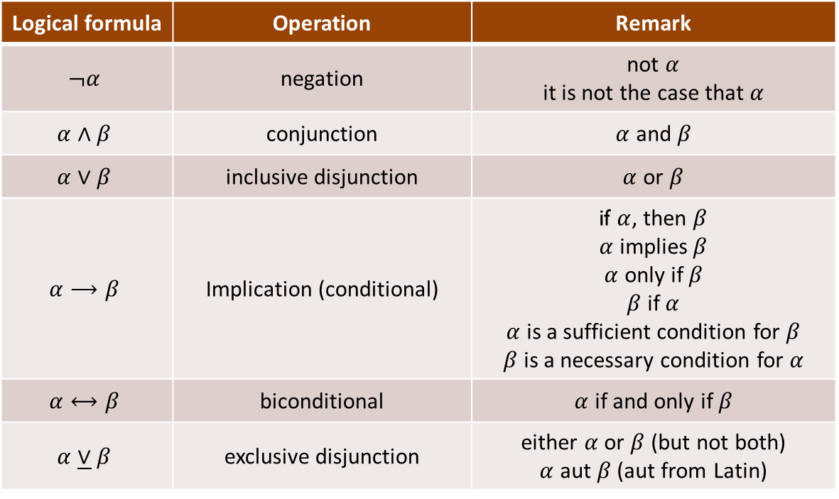
Recapitulation (ctd.)
A summary of logical symbols.

Slide 5
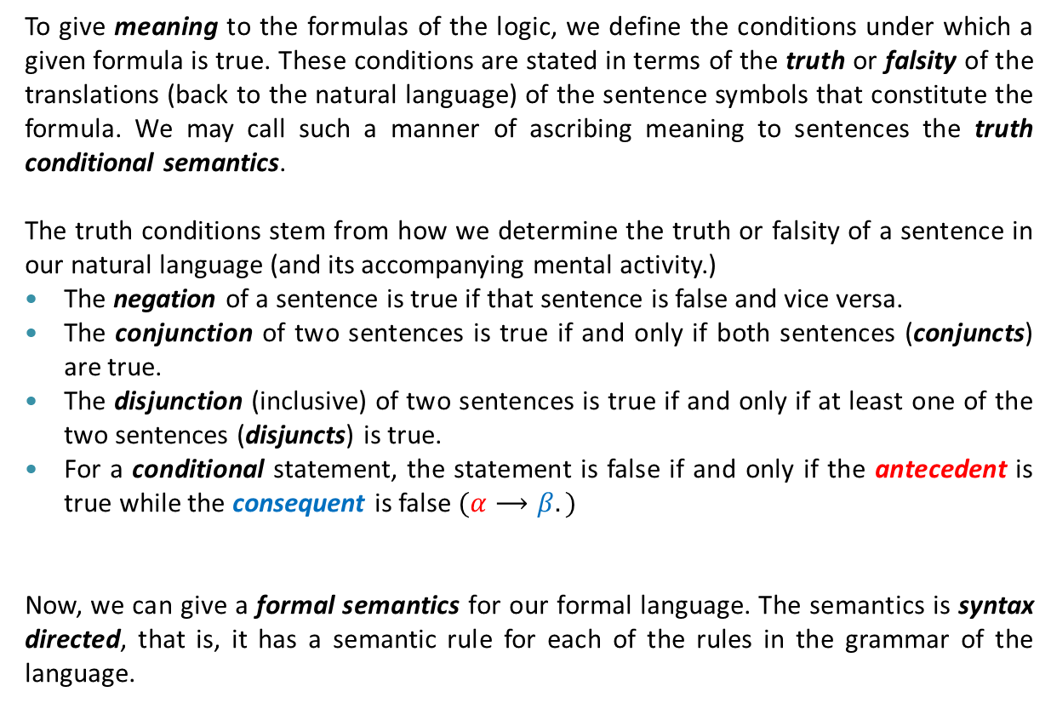
Semantics
To give meaning to the formulas of the logic, we define the conditions under which a given formula is true. These conditions are stated in terms of the truth or falsity of the translations (back to the natural language) of the sentence symbols that constitute the formula. We may call such a manner of ascribing meaning to sentences the truth conditional semantics.
The truth conditions stem from how we determine the truth or falsity of a sentence in our natural language (and its accompanying mental activity.)
The negation of a sentence is true if that sentence is false and vice versa.
The conjunction of two sentences is true if and only if both sentences (conjuncts) are true.
The disjunction (inclusive) of two sentences is true if and only if at least one of the two sentences (disjuncts) is true.
For a conditional statement, the statement is false if and only if the antecedent is true while the consequent is false $(α⟶β.)$
Now, we can give a formal semantics for our formal language. The semantics is syntax directed, that is, it has a semantic rule for each of the rules in the grammar of the language.

Slide 6







Semantics (ctd.)
Let $𝒜$ be the set of all sentence symbols (atomic proposition symbols) of the propositional logic. Then, a truth assignment $v$, also called a basic valuation function, is a function that maps every sentence symbol to one of the truth values 0 or 1, for falsity and truth, respectively.
Thus, a truth assignment is a function $v:𝒜⟶\{0,1\}$. It may also be called a model, since it is an assignment of truth values to atomic sentences, which indeed reflect the state of affairs.
We extend a truth assignment $v$ to $v^{∗}$ that assigns a (correct) truth value to each well-formed $α∈𝒮$ of the language. Given a truth assignment $v$, the extension $v^{∗}$, also called valuation function, is defined as follows:
For all $a∈𝒜$ and $α, β∈𝒮$,
$$v^{∗}\left(a\right)=v\left(a\right).$$
$$v^{∗}\left(\left(¬α\right)\right)=1−v^{∗}\left(α\right).$$
$$v^{∗}\left(⊥\right)=0.$$
$$v^{∗}\left(α∧β\right)=v^{∗}\left(α\right)v^{∗}\left(β\right).$$
$$v^{∗}\left(⊤\right)=1.$$
$$v^{∗}\left(α∨β\right)=v^{∗}\left(α\right){+ v}^{∗}\left(β\right)−v^{∗}\left(α\right)v^{∗}\left(β\right).$$
$$v^{∗}\left(α⟶β\right)={1−v}^{∗}\left(α\right)\left(1−v^{∗}\left(β\right)\right).$$

Slide 7













Semantics (ctd.)
Example 1. Let $v$ is a truth assignment such that $v\left(p\right)=1$ and $v\left(q\right)=0$. Calculate $v^{∗}(α)$ for $α=\left(p⟶\left(¬q\right)\right)$ and $α=\left(p∧\left(\left(¬p\right)∨q\right)\right)$.
Solution.
$$v^{∗}\left(\left(p⟶\left(¬q\right)\right)\right)=1−v^{∗}\left(p\right)\left(1−v^{∗}\left(\left(¬q\right)\right)\right)$$
$$=1−v^{∗}\left(p\right)\left(1−\left(1−v^{∗}\left(q\right)\right)\right)$$
$$=1−v^{∗}\left(p\right)v^{∗}(q)$$
$$=1−v\left(p\right)v(q)$$
$$=1$$
$$v^{∗}\left(\left(p∧\left(\left(¬p\right)∨q\right)\right)\right)=v^{∗}\left(p\right)v^{∗}\left(\left(\left(¬p\right)∨q\right)\right)$$
$$=v^{∗}\left(p\right)\left(v^{∗}\left(\left(¬p\right)\right)+v^{∗}\left(q\right)−v^{∗}\left(\left(¬p\right)\right)v^{∗}\left(q\right)\right)$$
$$=v^{∗}\left(p\right)\left({1−v}^{∗}\left(p\right)+v^{∗}\left(q\right)−\left(1−v^{∗}\left(p\right)\right)v^{∗}\left(q\right)\right)$$
$$=v^{∗}\left(p\right)\left({1−v}^{∗}\left(p\right)+v^{∗}\left(q\right)−v^{∗}\left(q\right)+v^{∗}\left(p\right)v^{∗}\left(q\right)\right)$$
$$=v\left(p\right)\left(1−v\left(p\right)+v\left(p\right)v\left(q\right)\right)$$
$$=v\left(p\right)−v\left(p\right)+v\left(p\right)v(q)$$
$$=v\left(p\right)v(q)$$
$$=0$$

Slide 8




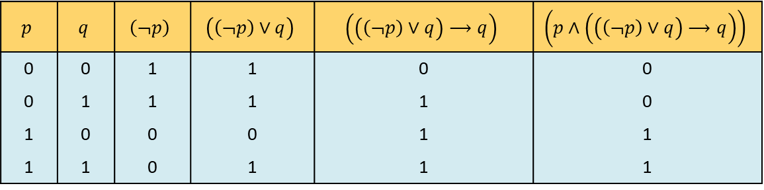

Semantics (ctd.)
The given semantics is compositional in the sense that the truth value of a formula only depends on the truth values of the atomic propositions that occur in the formula. Thus, to give meaning to a given formula, one can only consider the truth values of the sentence symbols in the formula. In fact, for a formula with $n$ distinct sentence symbols, one can consider $2^{n}$ different truth assignments $v$.
Sometimes, the truth values of a given formula with $n$ sentence symbols is shown as a table, called truth table for the formula, where each row of the table corresponds to a particular truth assignment. The first $n$ columns contain the truth values of sentence symbols and the last column contains those of the given formula. Other columns give the truth values of subformulas.
Example 2. Draw the truth table for the formula $\left(p∧\left(\left(\left(¬p\right)∨q\right)⟶q\right)\right)$.
Solution.
$$p$$ | $$q$$ | $$\left(¬p\right)$$ | $$\left(\left(¬p\right)∨q\right)$$ | $$\left(\left(\left(¬p\right)∨q\right)⟶q\right)$$ | $$\left(p∧\left(\left(\left(¬p\right)∨q\right)⟶q\right)\right)$$
0 | 0 | 1 | 1 | 0 | 0
0 | 1 | 1 | 1 | 1 | 0
1 | 0 | 0 | 0 | 1 | 1
1 | 1 | 0 | 1 | 1 | 1
$$v\left(p\right)=0$$
$$v\left(q\right)=0$$
$$v\left(p\right)=0$$
$$v\left(q\right)=1$$
$$v\left(p\right)=1$$
$$v\left(q\right)=0$$
$$v\left(p\right)=1$$
$$v\left(q\right)=1$$

Slide 9




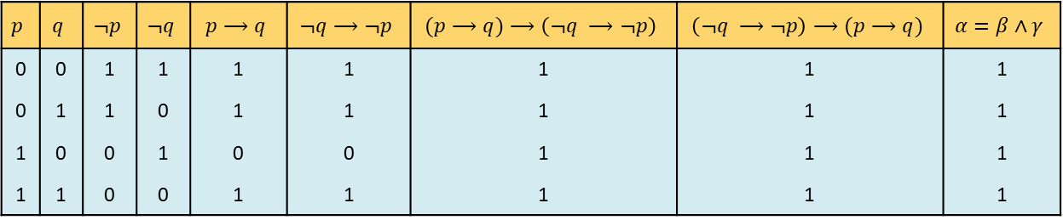
Semantics (ctd.)
Example 3. Draw the truth table for the formula $α=(p⟶q)⟷\left(¬q ⟶¬p\right)$.
Solution.
Exercise. Show that $v^{∗}\left( \left(p⟶q\right)⟷\left(¬q ⟶¬p\right)\right)=1$ for all $v:𝒜⟶\{0,1\}$.
The formulas $α$ with $v^{∗}\left(α\right)=1$ or $v^{∗}\left(α\right)=0$ for all $v:𝒜⟶\{0,1\}$ are very interesting. They indeed reflect the laws that govern deductive thought.
Definition 1. A formula $α$ of the propositional logic is said to be a valid formula, or a tautology, if it is always true, that is, $v^{∗}\left(α\right)=1$ for all truth assignments $v$. A formula $α$ with $v^{∗}\left(α\right)=0$ for all truth assignments $v$ is called a contradiction.
$$β$$
$$γ$$
$$p$$ | $$q$$ | $$¬p$$ | $$¬q$$ | $$p⟶q$$ | $$¬q⟶¬p$$ | $$(p⟶q)⟶\left(¬q ⟶¬p\right)$$ | $$\left(¬q ⟶¬p\right)⟶(p⟶q)$$ | $$α=β∧γ$$
0 | 0 | 1 | 1 | 1 | 1 | 1 | 1 | 1
0 | 1 | 1 | 0 | 1 | 1 | 1 | 1 | 1
1 | 0 | 0 | 1 | 0 | 0 | 1 | 1 | 1
1 | 1 | 0 | 0 | 1 | 1 | 1 | 1 | 1
The formula $(p⟶q)⟷\left(¬q ⟶¬p\right)$ is true in every model $v:𝒜⟶\left\{0,1\right\}.$

Slide 10
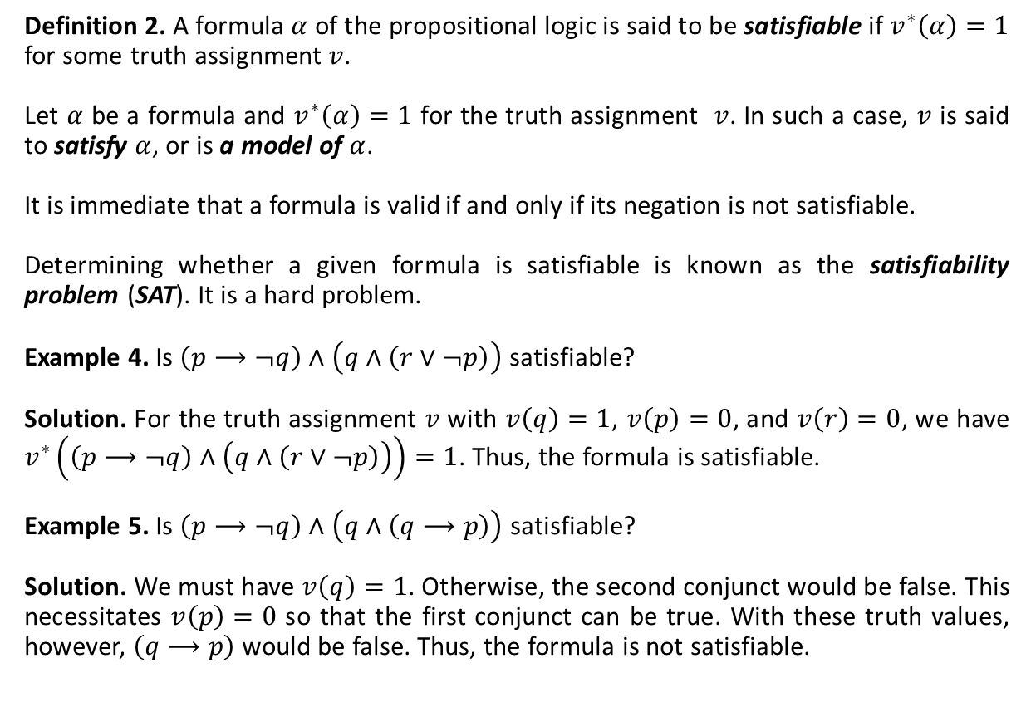
Semantics (ctd.)
Definition 2. A formula $α$ of the propositional logic is said to be satisfiable if $v^{∗}\left(α\right)=1$ for some truth assignment $v$.
Let $α$ be a formula and $v^{∗}\left(α\right)=1$ for the truth assignment $v$. In such a case, $v$ is said to satisfy $α$, or is a model of $α$.
It is immediate that a formula is valid if and only if its negation is not satisfiable.
Determining whether a given formula is satisfiable is known as the satisfiability problem (SAT). It is a hard problem.
Example 4. Is $\left(p⟶¬q\right)∧\left(q∧\left(r∨¬p\right)\right)$ satisfiable?
Solution. For the truth assignment $v$ with $v\left(q\right)=1$, $v\left(p\right)=0$, and $v\left(r\right)=0$, we have $v^{∗}\left(\left(p⟶¬q\right)∧\left(q∧\left(r∨¬p\right)\right)\right)=1$. Thus, the formula is satisfiable.
Example 5. Is $\left(p⟶¬q\right)∧\left(q∧\left(q⟶p\right)\right)$ satisfiable?
Solution. We must have $v\left(q\right)=1$. Otherwise, the second conjunct would be false. This necessitates $v\left(p\right)=0$ so that the first conjunct can be true. With these truth values, however, $\left(q⟶p\right)$ would be false. Thus, the formula is not satisfiable.

Slide 11
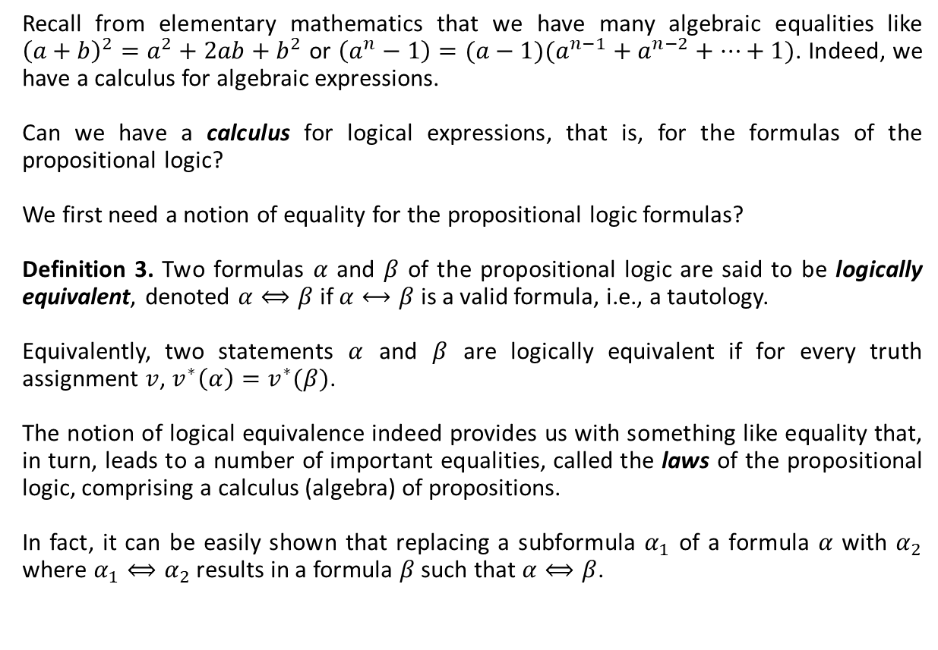
A Calculus for the Propositional Logic
Recall from elementary mathematics that we have many algebraic equalities like ${\left(a+b\right)}^{2}=a^{2}+2ab+b^{2}$ or $\left(a^{n}−1\right)=(a−1)(a^{n−1}+a^{n−2}+…+1)$. Indeed, we have a calculus for algebraic expressions.
Can we have a calculus for logical expressions, that is, for the formulas of the propositional logic?
We first need a notion of equality for the propositional logic formulas?
Definition 3. Two formulas $α$ and $β$ of the propositional logic are said to be logically equivalent, denoted $α⟺β$ if $α⟷β$ is a valid formula, i.e., a tautology.
Equivalently, two statements $α$ and $β$ are logically equivalent if for every truth assignment $v$, $v^{∗}\left(α\right)=v^{∗}(β)$.
The notion of logical equivalence indeed provides us with something like equality that, in turn, leads to a number of important equalities, called the laws of the propositional logic, comprising a calculus (algebra) of propositions.
In fact, it can be easily shown that replacing a subformula $α_{1}$ of a formula $α$ with $α_{2}$ where $α_{1}⟺α_{2}$ results in a formula $β$ such that $α⟺β$.

Slide 12
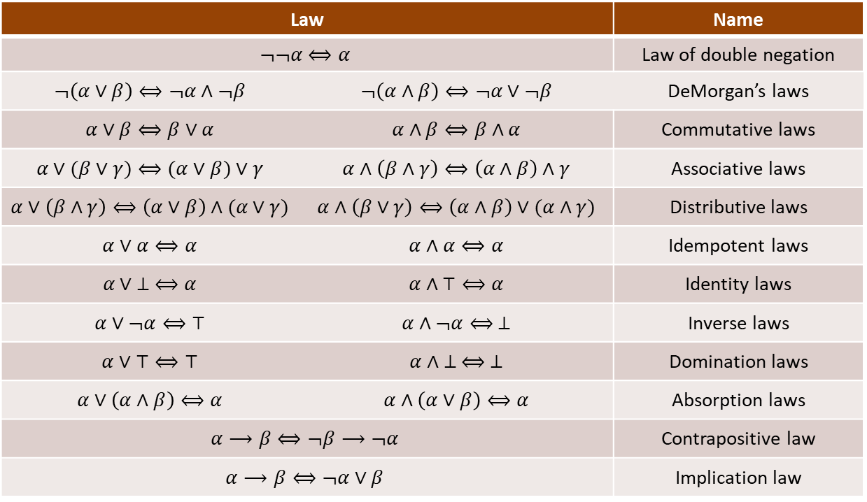
Algebra of propositions
The following table lists important laws for the algebra of propositions.
Law |  | Name
$$¬¬α⟺α$$ |  | Law of double negation
$$¬\left(α∨β\right)⟺¬α∧¬β$$ | $$¬\left(α∧β\right)⟺¬α∨¬β$$ | DeMorgan’s laws
$$α∨β⟺β∨α$$ | $$α∧β⟺β∧α$$ | Commutative laws
$$α∨(β∨γ)⟺(α∨β)∨γ$$ | $$α∧\left(β∧γ\right)⟺\left(α∧β\right)∧γ$$ | Associative laws
$$α∨\left(β∧γ\right)⟺\left(α∨β\right)∧(α∨γ)$$ | $$α∧\left(β∨γ\right)⟺\left(α∧β\right)∨(α∧γ)$$ | Distributive laws
$$α∨α⟺α$$ | $$α∧α⟺α$$ | Idempotent laws
$$α∨ ⊥ ⟺α$$ | $$α∧⊤⟺α$$ | Identity laws
$$α∨¬α⟺⊤$$ | $$α∧¬α⟺ ⊥$$ | Inverse laws
$$α∨⊤⟺⊤$$ | $$α∧ ⊥ ⟺ ⊥$$ | Domination laws
$$α∨\left(α∧β\right)⟺α$$ | $$α∧\left(α∨β\right)⟺α$$ | Absorption laws
$$α⟶β⟺¬β⟶¬α$$ |  | Contrapositive law
$$α⟶β⟺¬α∨β$$ |  | Implication law

Slide 13











Algebra of Propositions (Ctd.)
Example 6. Prove Demorgan’s law $¬\left(α∨β\right)⟺¬α∧¬β$.
Solution. We show that $v^{∗}\left(¬\left(α∨β\right)\right)=v^{∗}\left(¬α∧¬β\right)$ through the following steps.
The laws are not primitive in the sense that some can be obtained from the others. For example, the following is a derivation of the absorption law $α∨\left(α∧β\right)⟺α$.
$$v^{∗}\left(¬\left(α∨β\right)\right)=1−v^{∗}\left(α∨β\right)$$
$$=1−v^{∗}\left(α\right)−v^{∗}\left(β\right)+v^{∗}\left(α\right)v^{∗}\left(β\right)$$
$$=\left(1−v^{∗}\left(α\right)\right)\left(1−v^{∗}\left(β\right)\right)$$
$$=v^{∗}\left(¬α\right)v^{∗}\left(¬β\right)$$
$$=v^{∗}\left(¬α∧¬β\right)$$
$$α∨\left(α∧β\right)⟺(α∧⊤)∨\left(α∧β\right)$$
Identity law
$$⟺α∧(⊤∨β)$$
Distributive law
$$⟺α∧⊤$$
Domination law
$$⟺α$$
Identity law

Slide 14













Algebra of Propositions (Ctd.)
Example 7. Simplify the statement $¬\left(\left(p∧\left(p⟶q\right)\right)⟶q\right)$.
$$¬\left(\left(p∧\left(p⟶q\right)\right)⟶q\right)⟺¬\left(¬\left(p∧\left(p⟶q\right)\right)∨q\right)$$
Implication law
$$⟺¬¬\left(p∧\left(p⟶q\right)\right)∧¬q$$
DeMorgan’s law
$$⟺\left(p∧\left(p⟶q\right)\right)∧¬q$$
Law of double negation
$$⟺\left(p∧\left(¬p∨q\right)\right)∧¬q$$
Implication law
$$⟺\left(\left(p∧¬p\right)∨\left(p∧q\right)\right) ∧¬q$$
Distributive law
$$⟺\left(⊥ ∨\left(p∧q\right)\right) ∧¬q$$
Inverse law
$$⟺\left(\left(p∧q\right)∨ ⊥\right) ∧¬q$$
Commutative law
$$⟺\left(p∧q\right)∧¬q$$
Identity law
$$⟺¬q∧\left(p∧q\right)$$
Commutative law
$$⟺¬q∧(q∧p)$$
Commutative law
$$⟺(¬q∧q)∧p$$
Associative law
$$⟺ ⊥ ∧p$$
Inverse law
$$⟺ ⊥$$
Domination law

Slide 15
Textbook: Ralph P. Grimaldi, Discrete and Combinatorial Mathematics
You may also consult with other books about mathematical logic.

